Slide 1
CS 364 Software Engineering I
Brother Clements
Week 01: Day 1: Course Introduction

Slide 2
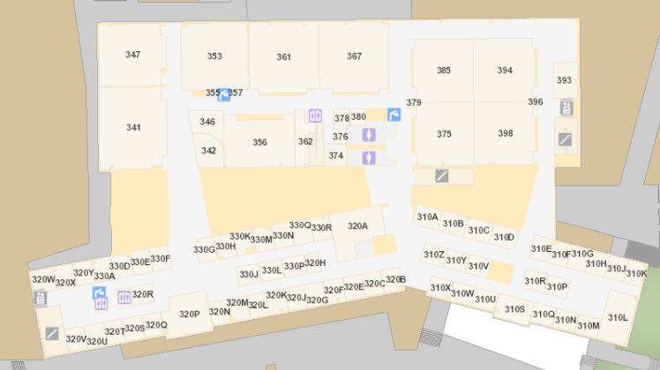
Bro Clements
William Clements
Email: ClementsW@byui.edu
Google Phone: (208) 557-4333
Office Phone: 208-496-7617
Office Rm: 320 T (Mark Twain with a T – Samuel Clemens)
Office hours: M-F 09:00 AM - 10:00 AM

Slide 3



ICE Breaker
You are a member of a space crew originally scheduled to rendezvous with a mother ship on the lighted surface of the moon.
However, due to mechanical difficulties, your ship was forced to land at a spot some 200 miles from the rendezvous point.
During reentry and landing, much of the equipment aboard was damaged and, since survival depends on reaching the mother ship, the most critical items available must be chosen for the 200-mile trip.
15 items left intact and undamaged after landing. Your task is to rank order them in terms of their importance for your crew in allowing them to reach the rendezvous point.
Place the number 1 by the most important item, the number 2 by the second most important, and so on through number 15 for the least important.
Please provide the reason why you would choose the order.
Please bring this back on Tuesday and Wednesday
Box of matches Food concentrate
50 feet of nylon rope Parachute silk
Portable heating unit Signal flares
Stellar map Self-inflating life raft
Magnetic compass 20 liters of water
One case of dehydrated milk
Two 100 lb. tanks of oxygen
Two .45 caliber pistols
First aid kit, including injection needle
Solar-powered FM receiver-transmitter

Slide 4
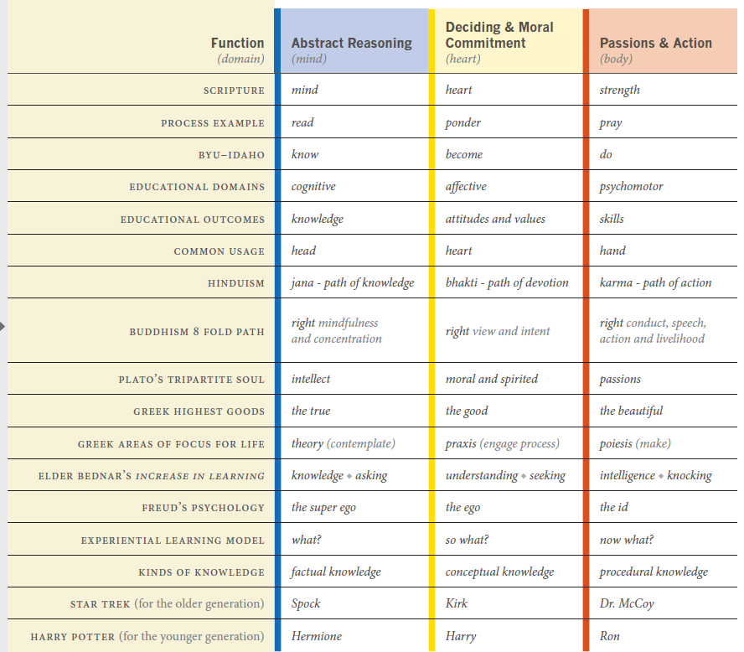

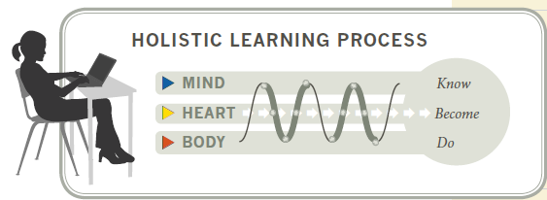
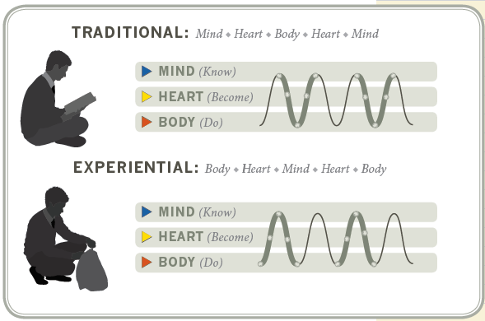
Learning @ BYU

Slide 5
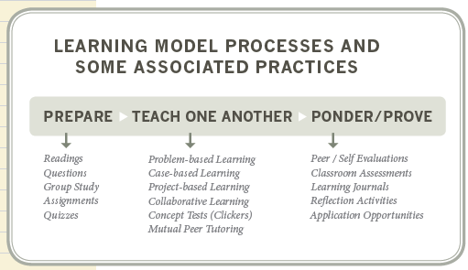
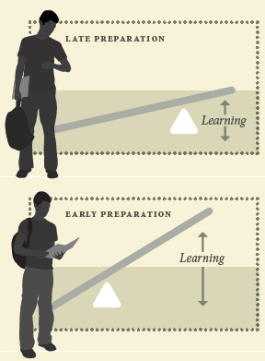
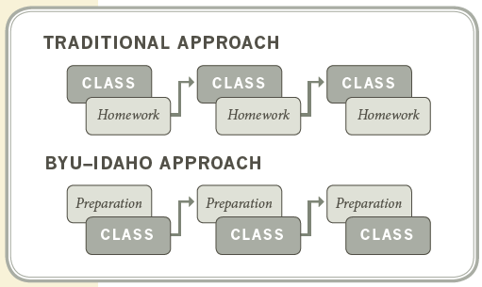
Learning @ BYU

Slide 6
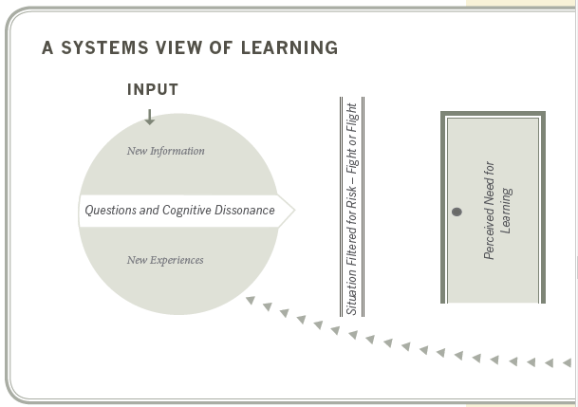
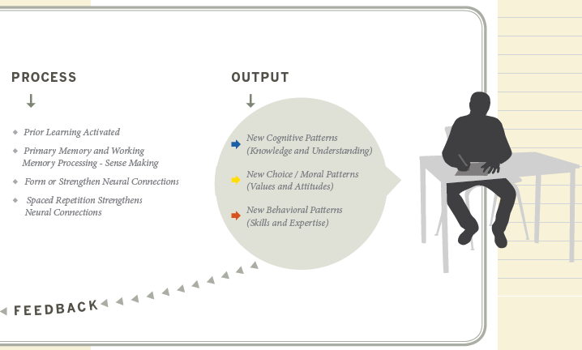
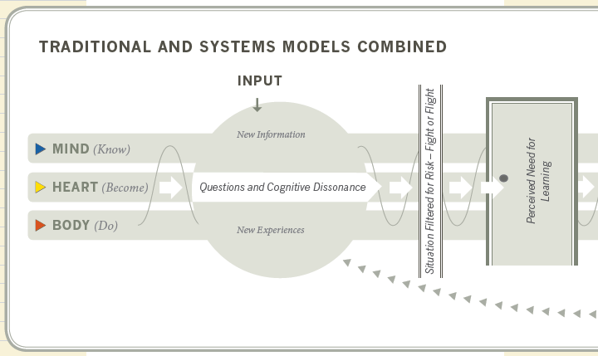
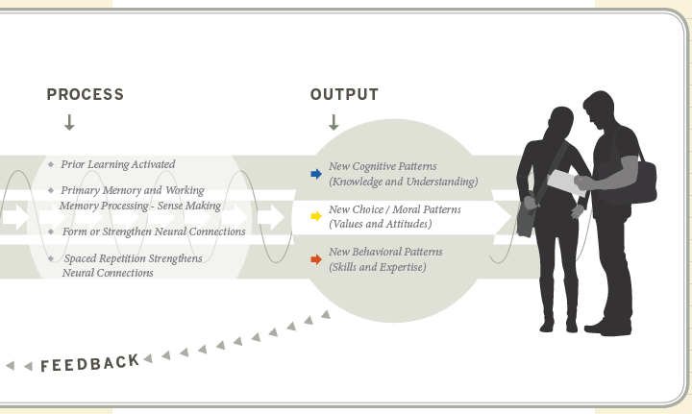
Learning @ BYU

Slide 7
Overview
There are two parts of CS 364:
Requirements engineering and
Requirements Engineering relates how we as software engineers come to understand the client's needs and how those needs are documented.
Design specification.
Design Specification relates to how we as software engineers develop and represent a design for a software system that meets the client's needs.

Slide 8
Objectives
Successful graduates of CS 364 will:
Critique the quality of a given article and identify the assumptions on which an author’s conclusions were made
Enumerate and explain the various parts of an SRS and SDD
Enumerate, define, compare & contrast, select, and use a variety of requirement elicitation techniques
Enumerate, define, select, and use a variety of approaches for documenting and reviewing a design
Develop and demonstrate team membership and team leadership skills
Accept the principles of software engineering and commit to apply them in the workplace.

Slide 9
Course Materials
There is no traditional textbook for CS 364. All the reading will be a collection of articles and publications provided as links through the course I-Learn site. This is all available through I-Learn:
Schedule : See iLearn Announcement
Assignments : Reading quizzes, in-class activities, and weekly deliverables
Reading : Links to articles that can be downloaded from the library, through iLearn

Slide 10

Syllabus - Policies
You may work with your classmates, but all submitted work must be original.
The penalty for copying or plagiarizing of assignments might be one or more of the following: zero on an assignment, being asked to withdraw from the class, a failing grade in the class, or disciplinary action by the university.
Homework assignments are to be completed as scheduled.
Late work is generally not accepted. However, assignments may be rescheduled for a limited number of emergency situations if you discuss your situation with me before (not on and especially not after) the scheduled due date. There will be no routine extensions of due dates; be prepared to justify any requests for extensions.

Slide 11

Accessibility
BYU-Idaho is committed to providing a working and learning atmosphere that reasonably accommodates qualified persons with disabilities. Reasonable academic accommodations are reviewed for all students who have qualified documented disabilities. Services are coordinated with the student and instructor by BYU-Idaho Disability Services. If you need assistance or feel you have been unlawfully discriminated against on the basis of disability, you may seek resolution through established policy and procedures.
If you have any disability that may impair your ability to complete this course successfully, please contact Disability Services as soon as possible, preferably before the beginning of the semester, in order to ensure that you receive appropriate accommodations.
Disability Services Contact Information:
Phone: (208) 496-9210
Email: disabilityservices@byui.edu
Fax: (208) 496-5210
Website: http://www.byui.edu/disabilities/disability-services

Slide 12
Schedule
Every week, there will be three parts to the lesson:
Prepare: Reading (usually research articles) and a reading quiz.
The purpose of this is to prepare us for class discussions and to learn the tools we will use later in the week.
Teach One Another: There are three main types of activities here.
First, there will be class discussions with points awarded according to the quality of participation. All the discussion points will be available before class so there should be no surprises.
Second, there will be three group presentations.
Third there will be evaluations
Finally, there will be work days to encourage progress on the SRS and SDD.
Ponder & Prove:
Every Saturday there will be a Ponder & Prove deliverable.
Most weeks, this will be a checkpoint for the SRS or SDD. Other weeks, it will pertain to the lesson.

Slide 13
Assessment
Preparation – 10%
Thirteen reading quizzes due Monday before class. For most weeks, there will be about 15 pages of reading.
Teach One Another – 20%
Attendance is required every class period. The Teach-One-Another component of the grade will be a combination of attendance and coming to class prepared. The definition of "prepared" will be presented in each individual week.
Ponder & Prove – 70%
Most weeks will have a Ponder & Prove assignment that will be graded. The weight of these assignments will vary from week to week.
The majority of the grade for CS 364 will come from two documents:
the SRS (20% of the Grade)
The SDD (40% of the Grade)
Some of this grade will come from the overall quality of the document (group effort),
Some will come from your contribution to the production of the document (individual effort).
The other 10% will be off of Individual Assignments & Presentation Tests.

Slide 14
Preparation (10% of Grade)
Weekly Reading will consist of different papers
https://content.byui.edu/file/9ff36283-aa31-4538-89a9-dc447f52b665/1/Course/364.References.html
Yes you are required to read these before you come to class.
Weekly Quizzes
Yes, they are designed to be tricky.

Slide 15
Teach One Another (20% of Grade)
There are several class Participation Categories, most are explained within iLearn for the associated day
First Week
Project Selection
Team Selection
Presentation topic selection (Week 01, Day 4) for 2nd Week
Other Weeks
Presentations
Class Scenario/Labs

Slide 16
Ponder & Prove – CLASS Projects (50% of 70% of Grade)
S/W Requirements SPEC (SRS) (15% of the Grade)
S/W Design Document (SDD) (35% of the Grade)
Ponder 03 : SRS Version 0
Ponder 04 : SRS Version 1
Ponder 05 : SRS Final
Ponder 08 : SDD Version 0
Ponder 09 : SDD Version 1
Ponder 11 : SDD Version 2
Ponder 12 : SDD Version 3
Ponder 14 : SDD Final
In addition, there is a Individual Feedback layer to this class.
You will be responsible for providing feedback about your group members, and rating their performance on a scale.
This will determine additional points toward the class projects.
grade = gradeIndividualFeedback x gradeDocument.
i.e. Individual Grade/Contribution is determined to be 89%, and the grade on the SRS is 85%, you would get 75% for the SRS.
i.e. Individual Grade/Contribution is determined to be 95%, and the grade on the SDD is 96%, you would get 91.2%% for the SRS.

Slide 17
Ponder & Prove Individual Feedback
Participation
Evaluation
You will be expected to be at class everyday.
You can be an Project Manager (1/class), a Group Lead (max 8), or and Individual Contributor.
You will be responsible for providing feedback on your groups performance (Weekly)
By providing positive feedback and
Rating individuals on a scale.
Note that your grade in the class will be directly correlated with your contribution to the project.
The more you participate, the higher your grade will tend to be.
Regardless of your position (PM, Lead, or IC), how you contribute in your position will lead to your grade.

Slide 18
Ponder & Prove – Weekly (remaining 20% of 70% Grade)
Individual Assignments (10%)
Feedback Participation (10%)
Individual Assignments
Ponder 01 : Individual Responsibility
Ponder 03 : Interview Data
Tests (Based off OF Presentations)
Ponder 02 : Elicitation Test
Ponder 07 : Design Test
Ponder 10 : Design Test
Ponder 13 : Final Exam
As part of this class you will be participating in feedback and performance reviews.
Weeks 03, 04, 05, 06
Weeks 08, 09, 10, 11, 12, 13, 14

Slide 19
Logistics
Late Policy
The department late policy: Everything is due on the due date.
My policy: Every assignment is due on the due date. You may resubmit assignment twice after it has been graded.
Expectations
This is a 4-credit class. We meet everyday.
It is expected that you have two hours of homework for every hour in class. Set aside two hours every day for this class.
So that is somewhere between 8-10 hours a week out side of class.
Most of your work will be down outside of class.
Inside of cl
Installing Block Management Program…
Initializing: Block it out now in your planner.

Slide 20
Break Down of my work week
Typical Work Week breakdown (40 hours)
2 hr 4 Scrum Meetings (prep, attendance, action items)
2 hr Sprint Planning (identified tasks to be done for that week)
2 hr Sprint Review/Retrospect (present tasks that were completed)
10 hrs Communication (Email, Conversations, Telephone, etc) [That is looking at it twice a day]
2 hr Team/Company Staff Meeting/Flow downs
4 hrs Peer reviews (Reviewing other teammates work)
Actual Work time: 18/40 hours
Time | Mon | Tues | Wed | Thur | Friday
8 | Comm | Comm | Comm | Comm | Comm
9 | Sprint Planning | Scrum | Scrum | Scrum | Scrum
10
11
12 | Lunch | Lunch | Lunch | Lunch | Lunch
1 | Comm | Comm | Comm | Comm | Comm
2 |  |  |  | Meeting | Review & Retro
3
4 |  | Reviews |  | Reviews
5 |  | Reviews |  | Reviews

Slide 21
Agenda
Tomorrow: Project Selection Overview
Wednesday: Team Selection
Thursday: Next Week Presentation Topic Selection
Friday: Work Day.
Due This Week
Reading
Ice Breaker

Slide 22
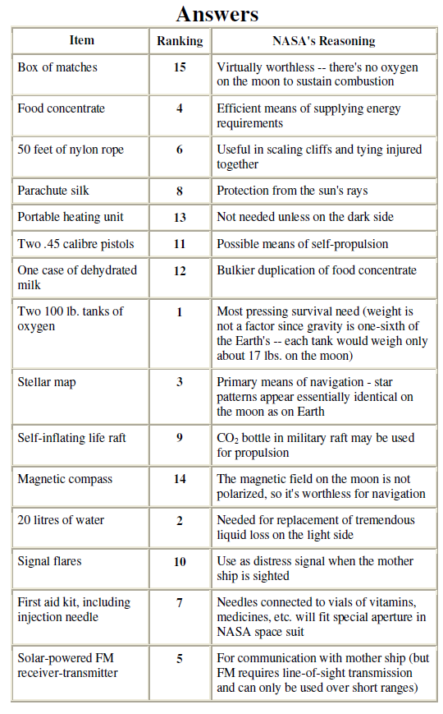

Slide 23
Item | NASA Reasoning | NASA Rank | Your Rank | Error Points
Box of Matches | No oxygen on the moon: worthless | 15
Food Concentrate | Efficient means of energy | 4
50ft Nylon rope | Useful in scaling cliffs, tying injured together, etc. | 6
Parachute silk | Sun protection | 8
Solar Powered heating unit | Not needed unless on dark side of the moon | 13
2 45Cal Pistols | Possible means of propulsion | 11
One case of dehydrated milk | Bulkier duplication of food concentrate | 12
Two 100lb oxygen tanks | Most pressing survival need | 1
Stellar Map | Primary means of navigation | 3
Self-inflating life raft | Co2 bottle in raft may be used for propulsion | 9
Magnetic Compass | Magnetic field on moon not polarized: useless | 14
5 gals. Water | Replacement for tremendous liquid loss on light side of moon | 2
Signal Flares | Distress signal when mother ship is located | 10
First-aid kit with injection needles | Needles fit special aperture in space suits | 7
Solar-powered FM 2-way radio | For communication with mother ship, but FM requires line-of-sight transmission, short range | 5

